Slide 1
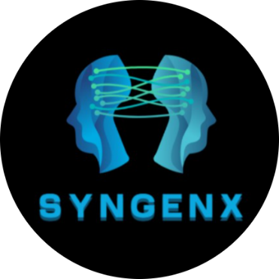





GENERATING REALISTIC SYNTHETIC DATA FOR ML
PID NO:4548
Author 1
Photo
Author 2
Photo
Author 3
Photo
Author 4
Photo
KARUNASAGARI S D
KAVIYA R
NAVEEN RAJ K
YOGHANAARAYANAN A
SRM TRP ENGINEERING COLLEGE
TIRCHIRAPPALLI
MS JEYAMEDONA P (AP/CSE)

Slide 2


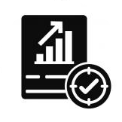
CHALLENGE STATEMENT
Data Scarcity
Limited real-world data restricts effective ML model training.
Privacy Risks
Sensitive data usage raises privacy and compliance concerns.
Synthetic Data Quality
Ensuring statistical accuracy and reliability of generated data is challenging.
4548

Slide 3
SCOPE OF SOLUTION
Data Scarcity
Use TVAE to generate high-quality synthetic data.
Privacy Risks
Apply Differential Privacy (Laplace Mechanism) to protect sensitive data.
Data Quality
Validate with KS-Test and Chi-Square Test to ensure accuracy.
4548

Slide 4
FEEDBACK FROM PRESENTATION ROUND AND ITS USE
Key Feedback from Jury/Mentors
Improve the statistical validation of synthetic data.
Enhance privacy mechanisms to ensure stronger compliance.
Optimize computational efficiency for faster data generation.
Improvements Implemented
Strengthened Differential Privacy with Laplace Mechanism to enhance security.
Optimized TVAE model parameters to reduce computation time while maintaining accuracy.
4548

Slide 5
SWOT ANALYSIS
STRENGTH
WEAKNESS
Solves Data Scarcity Generates synthetic data to fill gaps where real-world data is limited or unavailable.
Privacy-Preserving Uses differential privacy to protect sensitive information and comply with legal standards.
Statistical Accuracy Ensures that synthetic data retains key statistical relationships with the real dataset.
Scalability Can be applied across multiple industries, including healthcare, finance, and retail.
High Computational Cost Requires substantial GPU/TPU resources for training models.
Data Dependence The quality of synthetic data depends on the quality and diversity of the original dataset.
OPPORTUNITIES
THREATS
Growing Demand for Privacy-Compliant AI Increasing concerns over data privacy create a strong market for synthetic data solutions.
Regulatory Compliance Helps organizations comply with stringent regulations like GDPR, HIPAA, and CCPA.
Enhanced AI Training Improves machine learning models by providing diverse training datasets without breaching privacy rules.
Enterprise Adoption Businesses across industries are investing in AI-driven data solutions, creating potential partnerships.
Regulatory Changes Future data protection laws could impose new challenges for synthetic data use.
Competition Existing synthetic data providers (e.g., Gretel.ai, Mostly AI) could dominate the market.
4548

Slide 6
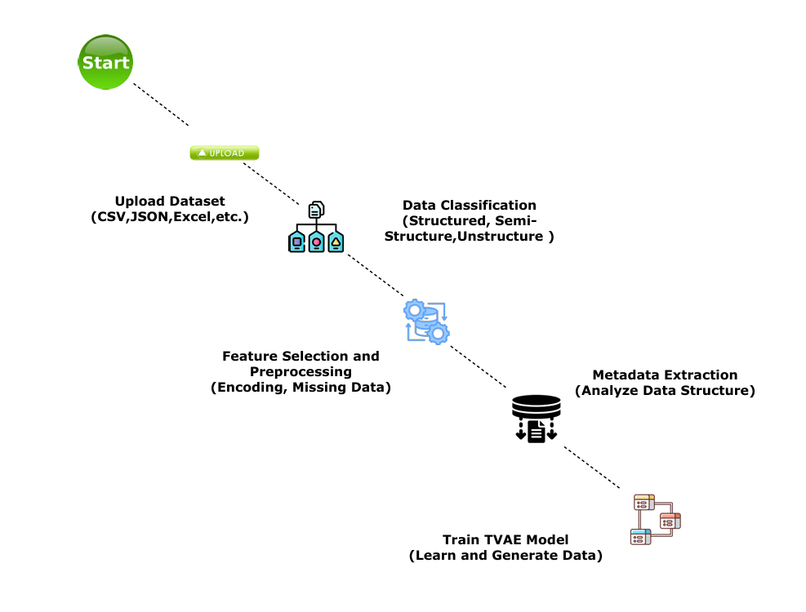
IMPLEMENTATION (1/2)
4548

Slide 7
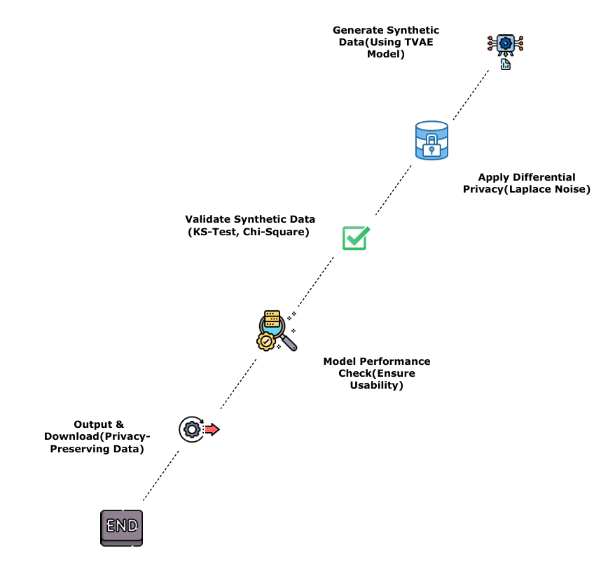
IMPLEMENTATION (2/2)
4548

Slide 8
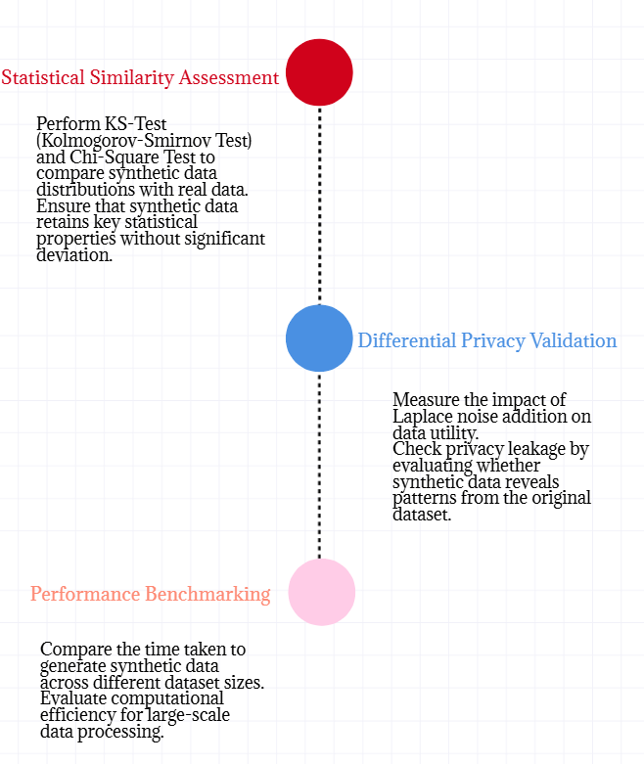
TESTING / ANALYSIS (1/2)
4548

Slide 9
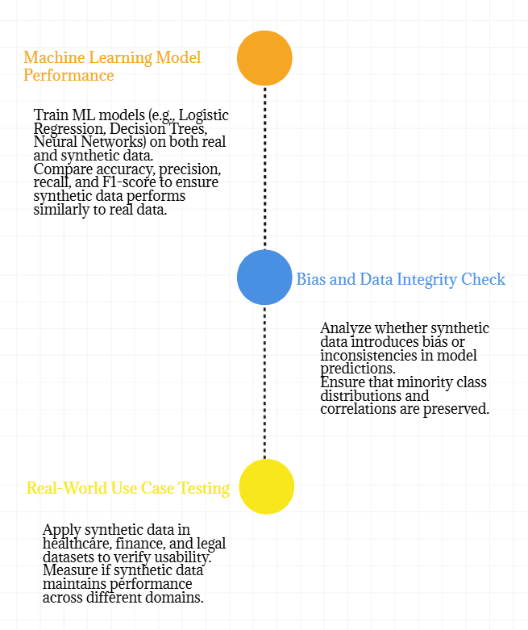
TESTING / ANALYSIS (2/2)
4548

Slide 10
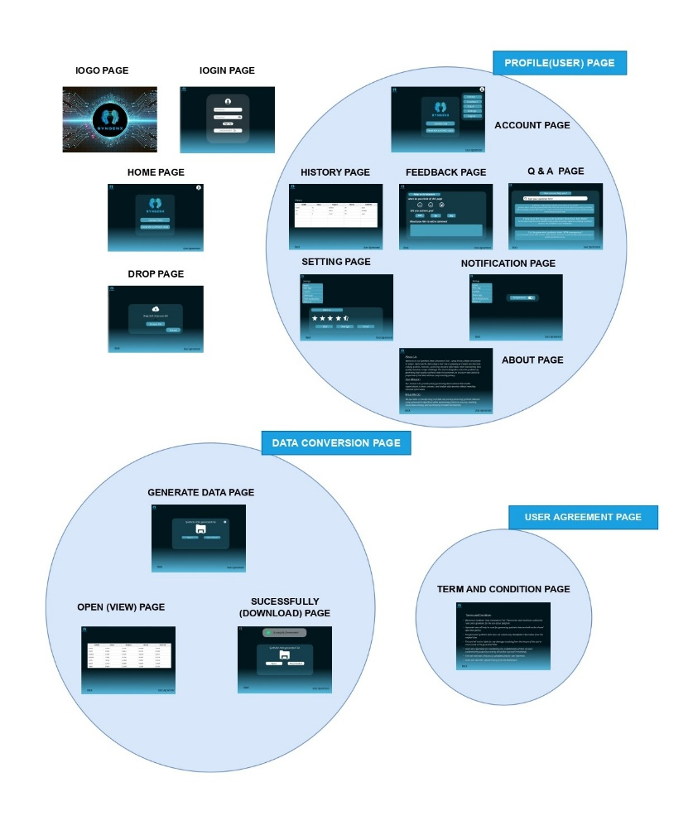
POC DEMO
PROTOTYPE DESIGN
SynGenX_EXPLANATION VIDEO
https://drive.google.com/file/d/1AXBxRecy13DZ_N8hJACG0D5ODMhcpIzT/view?usp=drivesdk
SynGenX_PROTOTYPE DESIGN VIDEO
https://drive.google.com/file/d/1AjtFwmtObpweVpsStduZx_VzzpP2MLyy/view?usp=drivesdk
PROGRAM_EXECUTION VIDEO
https://drive.google.com/drive/folders/1wkRaxjI27da7A0cwunAb2iI6gxa0gWZF?usp=sharing
4548

Slide 11
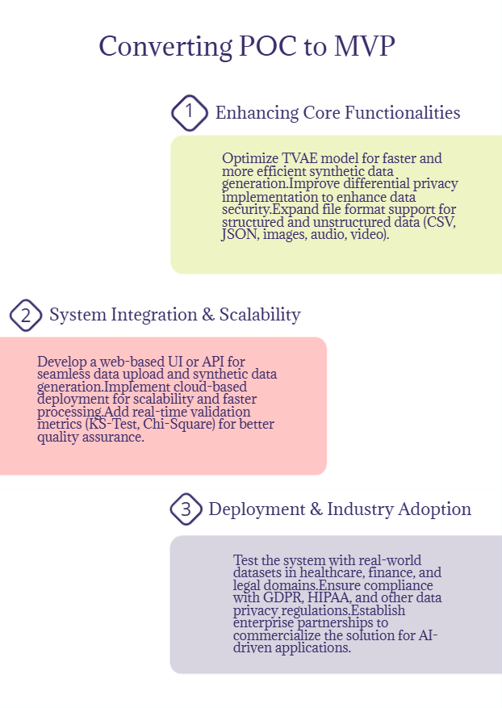
HIGH LEVEL PLAN FOR CONVERTING POC TO MVP
4548

Slide 12
COST FOR POC VS MVP
Cost Factors | POC (Proof of Concept) (INR) | MVP (Minimum Viable Product) (INR)
Development Effort | ₹30,000 – ₹80,000 | ₹3,00,000 – ₹7,00,000
Computational Resources | ₹15,000 – ₹50,000 | ₹3,00,000 – ₹8,00,000
Data Storage & Handling | ₹8,000 – ₹30,000 | ₹2,00,000 – ₹5,00,000
Privacy & Security | ₹8,000 – ₹30,000 | ₹1,50,000 – ₹3,50,000
Validation & Testing | ₹3,000 – ₹10,000 | ₹1,50,000 – ₹3,00,000
Deployment & Scalability | ₹5,000 – ₹50,000 | ₹3,00,000 – ₹7,00,000
Miscellaneous Costs | ₹5,000 – ₹30,000 | ₹30,000 – ₹1,50,000
Total Estimated Cost | ₹74,000 – ₹2,80,000 | ₹11,30,000 – ₹30,00,000
4548

Slide 13
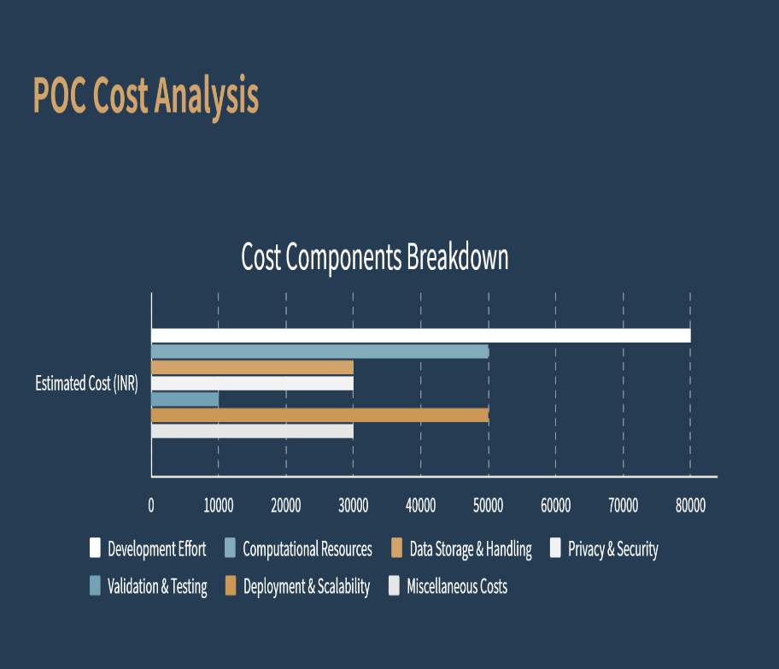
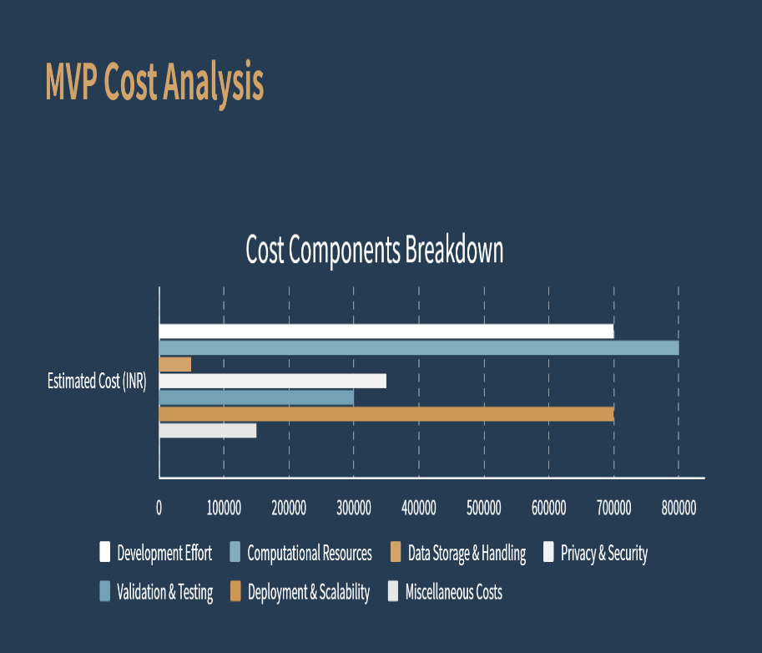
COST FOR POC VS MVP
4548

Slide 14
CONCLUSION
The system successfully generates high-quality synthetic datasets using TVAE while preserving statistical integrity. Differential privacy techniques, such as the Laplace Mechanism, ensure data security and compliance with regulations. The synthetic data maintains model accuracy, prevents overfitting, and supports structured and unstructured data across various industries, including healthcare, finance, and legal. This approach provides a scalable, privacy-preserving, and reliable alternative to real-world data, making it suitable for secure AI-driven applications.
4548

Slide 15
REFERENCES
Kingma & Welling (2014), Patki et al. (2016), and Zhang et al. (2019) – Research on Variational Autoencoders (VAEs), Synthetic Data Vault (SDV), and Self-Attention GANs (SAGANs) for realistic data generation.
Abadi et al. (2016) – Study on Differential Privacy in Deep Learning, influencing privacy mechanisms like the Laplace Mechanism used in this system.
Implementation Resources – Utilized SDV, Diffprivlib, TensorFlow, PyTorch, with documentation from TensorFlow Privacy and IBM Differential Privacy Library.
4548

Slide 16
THANK YOU!

